Slide 1
Hyperbolic trigonometry, polygons, Hyperbolic area; Gauss Bonnet, Hyperbolic tessellations
Kwok Ho Man 1155110697
Ma Ka Leong 1155108199

Slide 2
Outline
1.Hyperbolic polygon(Ma)
2.Hyperbolic area(Ma)
3.Gauss Bonnet theorem(Ma)
4.Hyperbolic trigonometry (Kwok)
5.Hyperbolic tessellation(Kwok)

Slide 3
Hyperbolic Polygon

Slide 4
Definition
A hyperbolic polygon is a closed convex set in the hyperbolic plane that can be expressed as the intersection of a locally finite collection of closed half-planes.

Slide 5
Closed and Convex Set
Let (U,d) be a hyperbolic plane.
open set in (U,d):
Let O be a subset of U , ∀ x ∈ O, ∃ ε > 0 s.t. {y ∈ U : d(x,y)< ε} ⊂ A
closed set:
Let C be a subset of U, if the complement of C is open.
convex set:
Let A be a subset of U, ∀ x,y distinct in A, the closed hyperbolic line segment ℓxy joining x to y is contained in A.

Slide 6
Example of Convex Set
open half-planes
closed half-places
hyperbolic lines
hyperbolic rays
hyperbolic line segments
intersection of two convex set

Slide 7
Convexity under Intersection
Let X,Y be convex sets.
∀ x,y ∈ X∩Y, x,y ∈ X.
Since X is convex, the hyperbolic line joining x,y lies in X.
Also, ∀ x,y ∈ X∩Y, x,y ∈ Y.
Since Y is convex, the hyperbolic line joining x,y lies in Y.
Since x,y defines an unique line, the hyperbolic line joining x,y lies in X∩Y
X∩Y is convex.

Slide 8
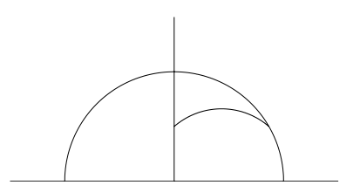
Example of Non-convex Set
let ℓ1,ℓ2 be hyperbolic line in the hyperbolic plane.
ℓ1⋃ℓ2 is not convex.
Prove: pick x on ℓ1 and y on ℓ2, where both x,y ∉ ℓ1∩ℓ2.
then the any the hyperbolic line segment joining x,y does
not lies in ℓ1⋃ℓ2
Remark: Since ℓ1 , ℓ2 are convex and ℓ1⋃ℓ2 is not, convexity
does not behave well under union

Slide 9
Locally Finite Collection
Let ℌ = {Hα}, α∈A be a collection of half-planes in the hyperbolic plane
ℓα be the bounding line for each Hα.
ℌ is locally finite Collection
if for each point z in the hyperbolic plane, ∃ ε > 0 s.t only finitely many ℓα intersect the open hyperbolic disc Uε(z).
If each Hα is closed i.e. ℓα ⊂ Hα, ℌ is a collection of closed half-planes.
Remark: If the ℌ is finite, ℌ is locally finite.

Slide 10
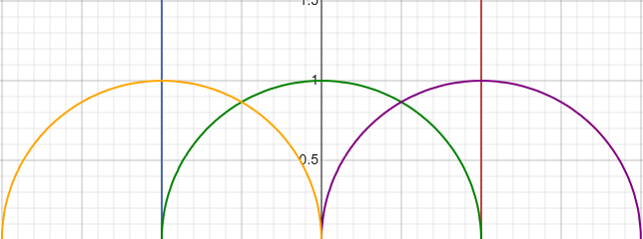
Examples of Hyperbolic Polygon
Example 1:
Let H1 = {z ∈ ℍ | Re(z) ≤ 1}, H2 = {z ∈ ℍ | Re(z) ≥ −1}, H3 = {z ∈ ℍ | |z| ≥ 1}, H4 = {z ∈ ℍ | |z − 1| ≥ 1}, and H5 = {z ∈ ℍ | |z + 1| ≥ 1}. Then, ∩Hn,n=1,2,3,4,5 is a polygon in upper half-plane

Slide 11
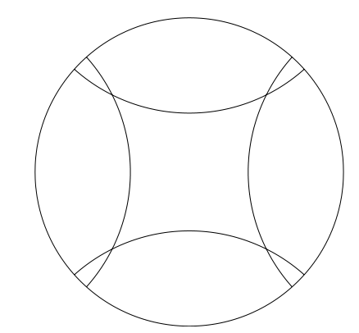
Examples of Hyperbolic Polygon
Example 2:
Let H1 = {z ∈ ℍ | |z|≤1}, H2 = {z ∈ ℍ | |z-i|≥1}, H3 = {z ∈ ℍ | |z+i| ≥ 1}, H4 = {z ∈ ℍ | |z − 1| ≥ 1}, and H5 = {z ∈ ℍ | |z + 1| ≥ 1}. Then, ∩Hn,n=1,2,3,4,5, is a polygon

Slide 12
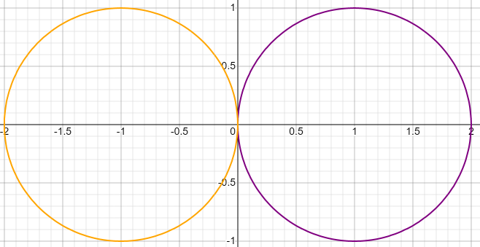
Examples of Hyperbolic Polygon
Example 3:
H1 = {z ∈ ℍ | |z-i| ≤ 1}, H2 = {z ∈ ℍ | |z+i| ≤ 1} then H1∩H2 is a polygon
i.e. A point can be a polygon

Slide 13
Nondegenerate & Degenerate Polygon
Nondegenerate: non-empty interior.
e.g. example1,2
Degenerate: empty interior.
e.g. example3
In fact: a polygon is degenerate iff it is either
(i) hyperbolic line
(ii) a closed hyperbolic ray
(iii) a closed hyperbolic line segment
(iv) a point.

Slide 14
Decomposition of Polygon
let ℓ be a hyperbolic line that intersects polygon P.
Case1: it passes throung interior of P
ℓ∩P is either
(i) closed hyperbolic line segment in ℓ
(ii) a closed hyperbolic ray in ℓ,
(iii) ℓ.
Case2: it does not passes throung interior of P
ℓ∩P is either
(i) a point in ℓ (in this case, that point is called vertex of P)
(ii) closed hyperbolic line segment in ℓ
(iii) a closed hyperbolic ray in ℓ
(iv) ℓ

Slide 15
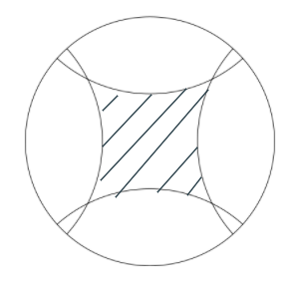
Vertices of Polygon
Textbook Definition:
let P be a hyperbolic polygon and let ℓ be a hyperbolic line so that P intersects ℓ and so that P is contained in a closed half-plane determined by ℓ. If the intersection P ∩ ℓ is a point, we say that this point is a vertex of P.
equivalent definition:
Each vertex v of a hyperbolic polygon P is the intersection of two adjacent sides of P

Slide 16
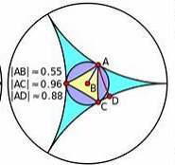
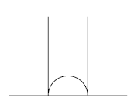
Ideal Vertex
If two sides intersect at boundary of the plane or at ∞

Slide 17
Example of polygon having ideal Vertex
The circled vertex is an ideal vertex in upper half-plane.

Slide 18
Example of polygon having ideal Vertex
The shaded region have an ideal vertex at ∞.

Slide 19

Interior Angle of Polygon
It takes place at the vertices of the polygon.
Suppose the vertex v is the intersection of two sides s1 and s2. Let ℓk be hyperbolic line contains sk.
Then ℓ1, ℓ2 cuts the plane into four parts.
There is one part containing P, the angle between ℓ1,ℓ2 measured in that part is the interior angle of P at v
Remark: interior angle lies in (0,𝜋).
If the vertex is an ideal vertex, the angle is 0
ℓ1
ℓ2

Slide 20
Reasonable hyperbolic Polygon
Definition:
A finite-sided polygon P in the hyperbolic plane is reasonable if P does not contain an open half-plane.
Property:
(i) every adjacent pair of sides shares either a vertex or an ideal vertex.
(ii) sum of number of vertex and ideal vertex = number of sides

Slide 21
Hyperbolic Area

Slide 22
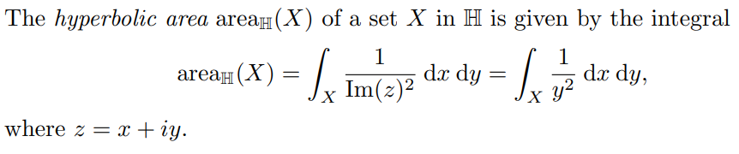
Formular
Remark: X need not to be a polygon.

Slide 23

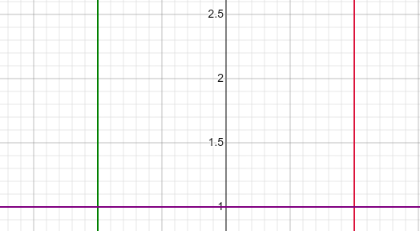
Examples
Example1:
Let X be a region bounded by H1={z ∈ ℍ | Re(z) = −1}, H2={z ∈ ℍ | Re(z)=1}, and H3={z ∈ ℍ |Im(z)=1}.
Then,

Slide 24




Examples
Example2: X is bounded by H1 = {z ∈ ℍ | Re(z) = 1}, H2 = {z ∈ ℍ | Re(z) = −1}, H3 = {z ∈ ℍ | |z| = 1}, H4 = {z ∈ ℍ | |z − 1| = 1}, and H5 = {z ∈ ℍ | |z + 1| = 1}
=
=

Slide 25

Hyperbolic Area and Mobius Transformation
Hyperbolic Area in ℍ is invariant under the action of Mob(ℍ)
Assumptions:
(i) X is set in ℍ
(ii) Hyperbolic area of X is defined
(iii) A is an element of Mob(ℍ)
Result:
Since the proof is too long, we will omit the proof.

Slide 26


Hyperbolic Area in Poincare disc.
OR
, x=rcos(θ) and y=rsin(θ)

Slide 27




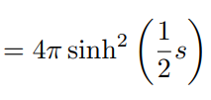
Examples
Example 1:
=

Slide 28
Isoperimetric Inequality
It tells us the maximum area of all regions bounded by simple closed curves of a fixed length.

Slide 29
Gauss Bonnet Formula

Slide 30
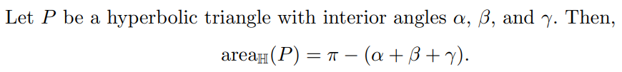
Gauss Bonnet Formula

Slide 31






Proof of Gauss Bonnet Formula
Let v1, v2 ,v3 be vertex of hyperbolic triangle P with 𝛼k as the interoir angle of vk for k=1,2,3
Case1: v1 is ideal, v2,v3 might or might not be ideal
Since Hyperbolic Area in ℍ is invariant under the action of Mob(ℍ), we can let γ be an element of Mob(ℍ) that takes v1 to ∞ and takes ℓ23 to the hyperbolic line contained in the unit circle, so that
,by substituting x = cos(𝓌)
Since 𝛼1=0,𝛼2 = θ and 𝛼3 =𝜋 - 𝜑, we have 𝜋-(𝛼1+𝛼2+𝛼3) = 𝜋-( θ+ 𝜋 - 𝜑)= 𝜑-θ =

Slide 32

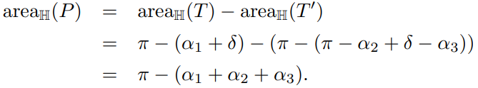
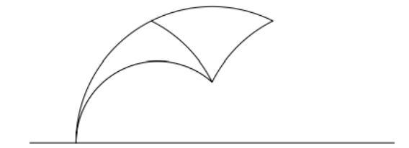
Proof of Gauss Bonnet Formula
Case 2: No ideal vertex
Let ℓ be the hyperbolic ray from v1 passing through v2, and let x be the endpoint at infinity of ℓ.
Let T be the hyperbolic triangle with vertex v1,v3,x and interior angle of T at v3 = 𝛿 > 𝛼3
T’ be the hyperbolic triangle with vertex v2,v3,x, and interior angle of T’ at v3 = 𝛿 - 𝛼3
By case1,
and
Then,
v2
v1
ℓ
v3
x

Slide 33
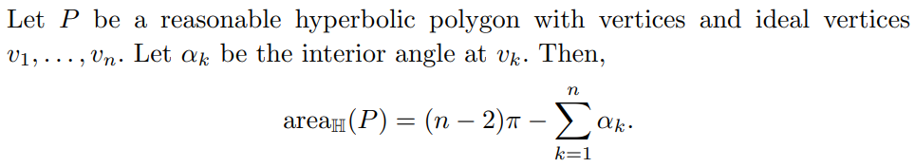

Application of Gauss Bonnet Formula
1
1
1

Slide 34
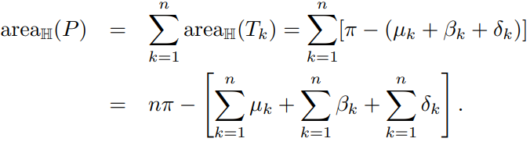
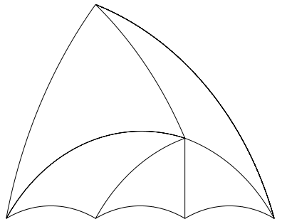


Proof - Application 1
Any Reasonable hyperbolic polygon can be decomposed into hyperbolic triangles
Label them as T1,T2,...,Tn so Tk has vertices x, vk,v(k+1).
Let μk be the interior angle of Tk at x. Then sum of μk from 1 to n = 2𝜋.
Let 𝛽k be the interior angle of Tk at vk and 𝛿k be the interior angle of Tk at v(k+1).
Let 𝛼k be the interior angle of P at vk.
Then 𝛼(k+1) = 𝛿k + 𝛽(k+1)
For each Tk,
x

Slide 35
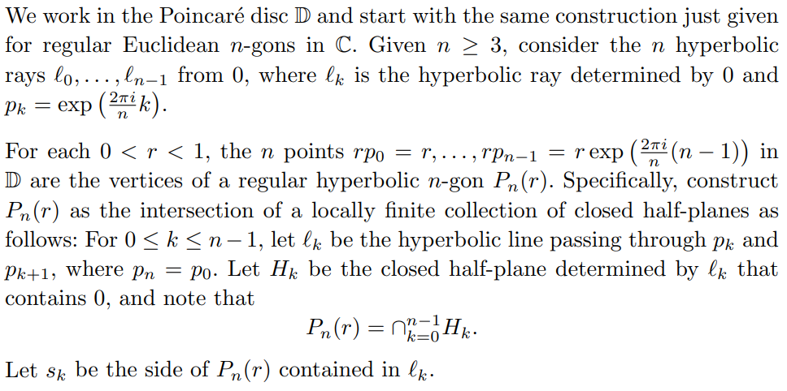
Proof - Application 2

Slide 36
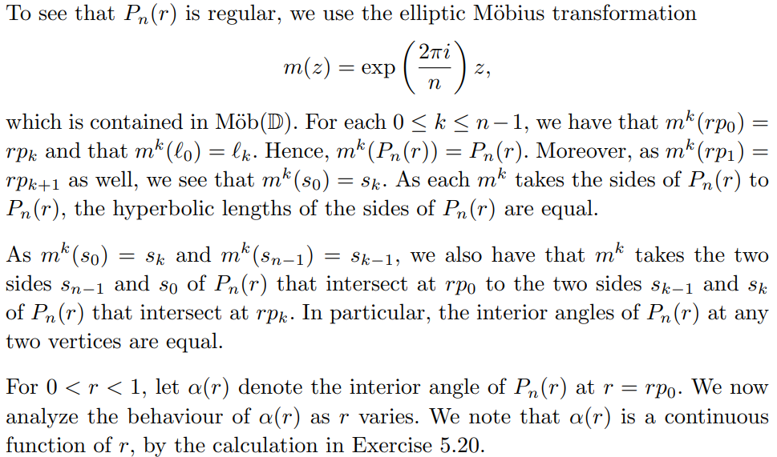
Proof - Application 2

Slide 37
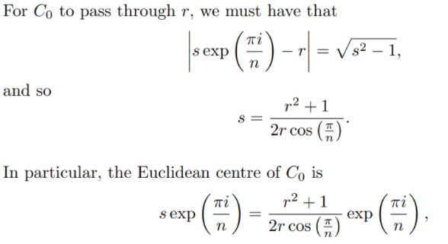
Proof - Application 2

Slide 38
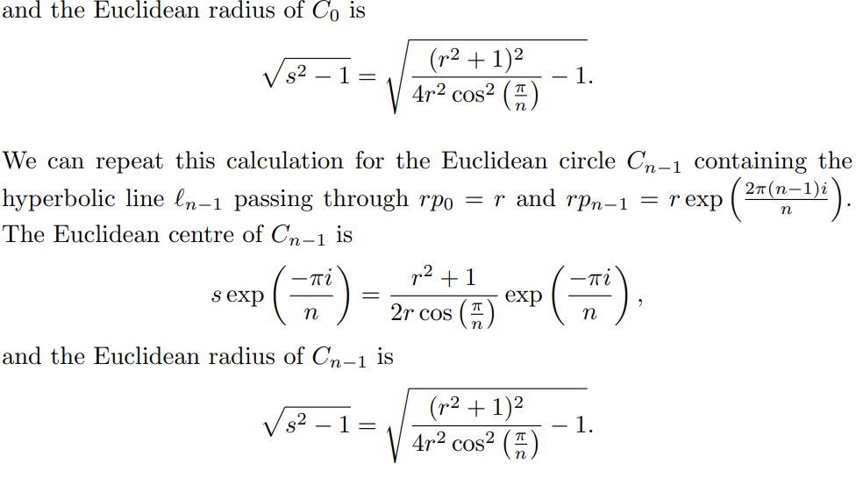
Proof - Application 2

Slide 39
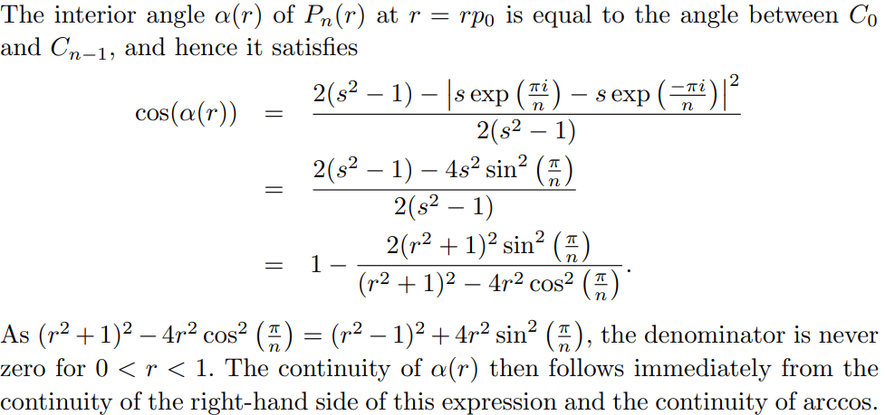
Proof - Application 2

Slide 40
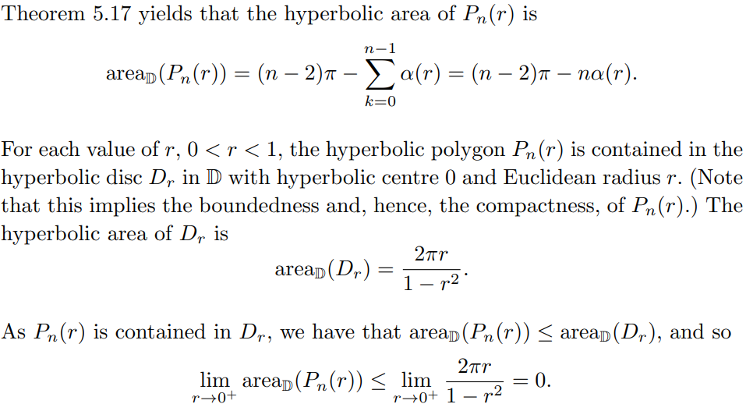
Proof - Application 2

Slide 41
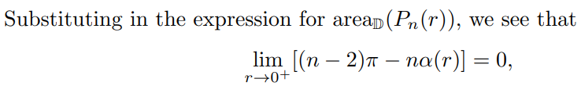



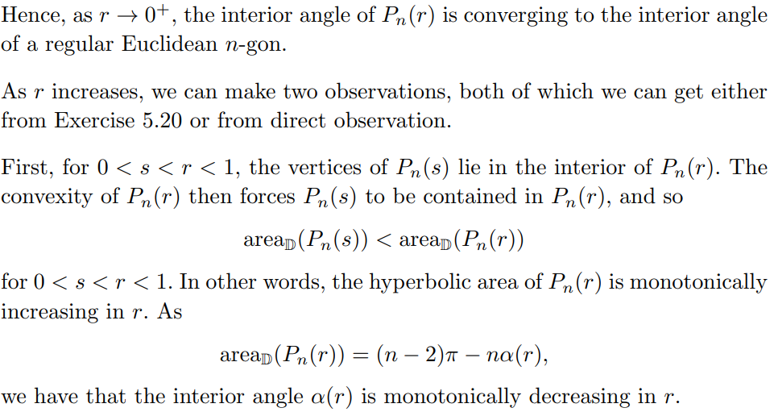
Proof - Application 2

Slide 42
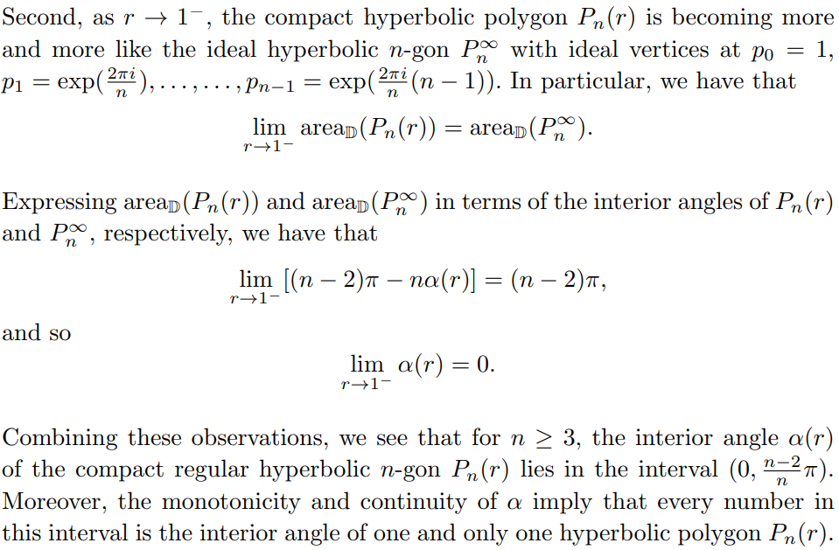
Proof - Application 2

Slide 43
Corollary of Application 2
There is no hyperbolic squares.
Proof:
The interval of possible interior angles of a compact regular hyperbolic 4-gon is (0, ((4-2)/2)π)=(0,π/2)
Hence, there is no hyperbolic 4-gon with all right angles.
i.e. no hyperbolic squares
For n ≥ 5, there exists a compact regular hyperbolic n-gon all of whose interior angles are right angles.
Proof:
For n ≥ 5, the interval of possible angles of a regular hyperbolic n-gon is (0, ((n−2)/n)π). As (n−2)/n > 1/2 for n ≥ 5, this interval contains π/2, and so there exists a regular hyperbolic n-gon with all right angles.

Slide 44
Hyperbolic Trigonometry

Slide 45
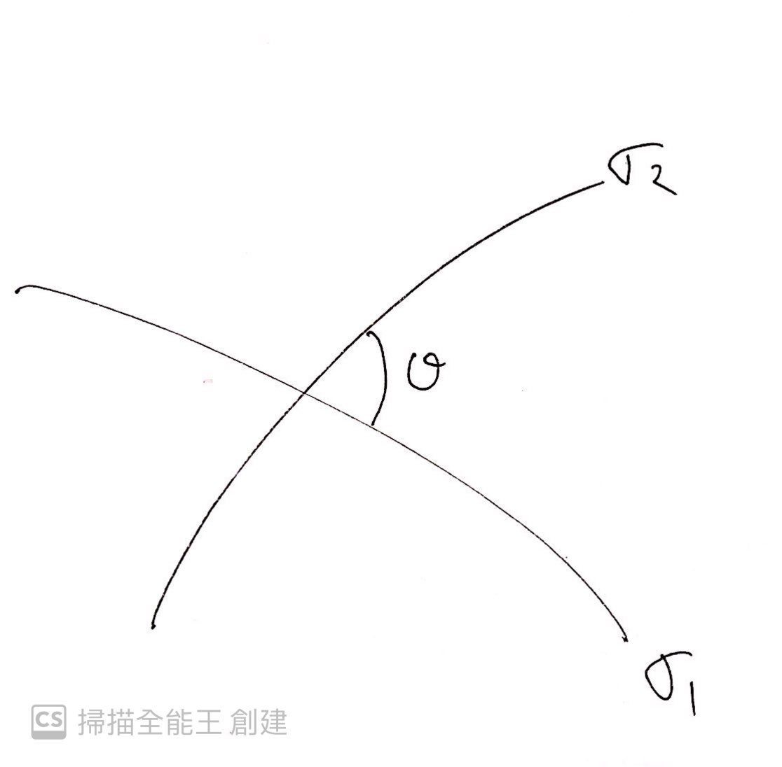
Angle
Suppose that we have two paths σ1 and σ2 that intersect at the point z ∈ ℍ . By choosing appropriate parametrizations of the paths, we can assume that z = σ1(0) = σ2(0).

Slide 46
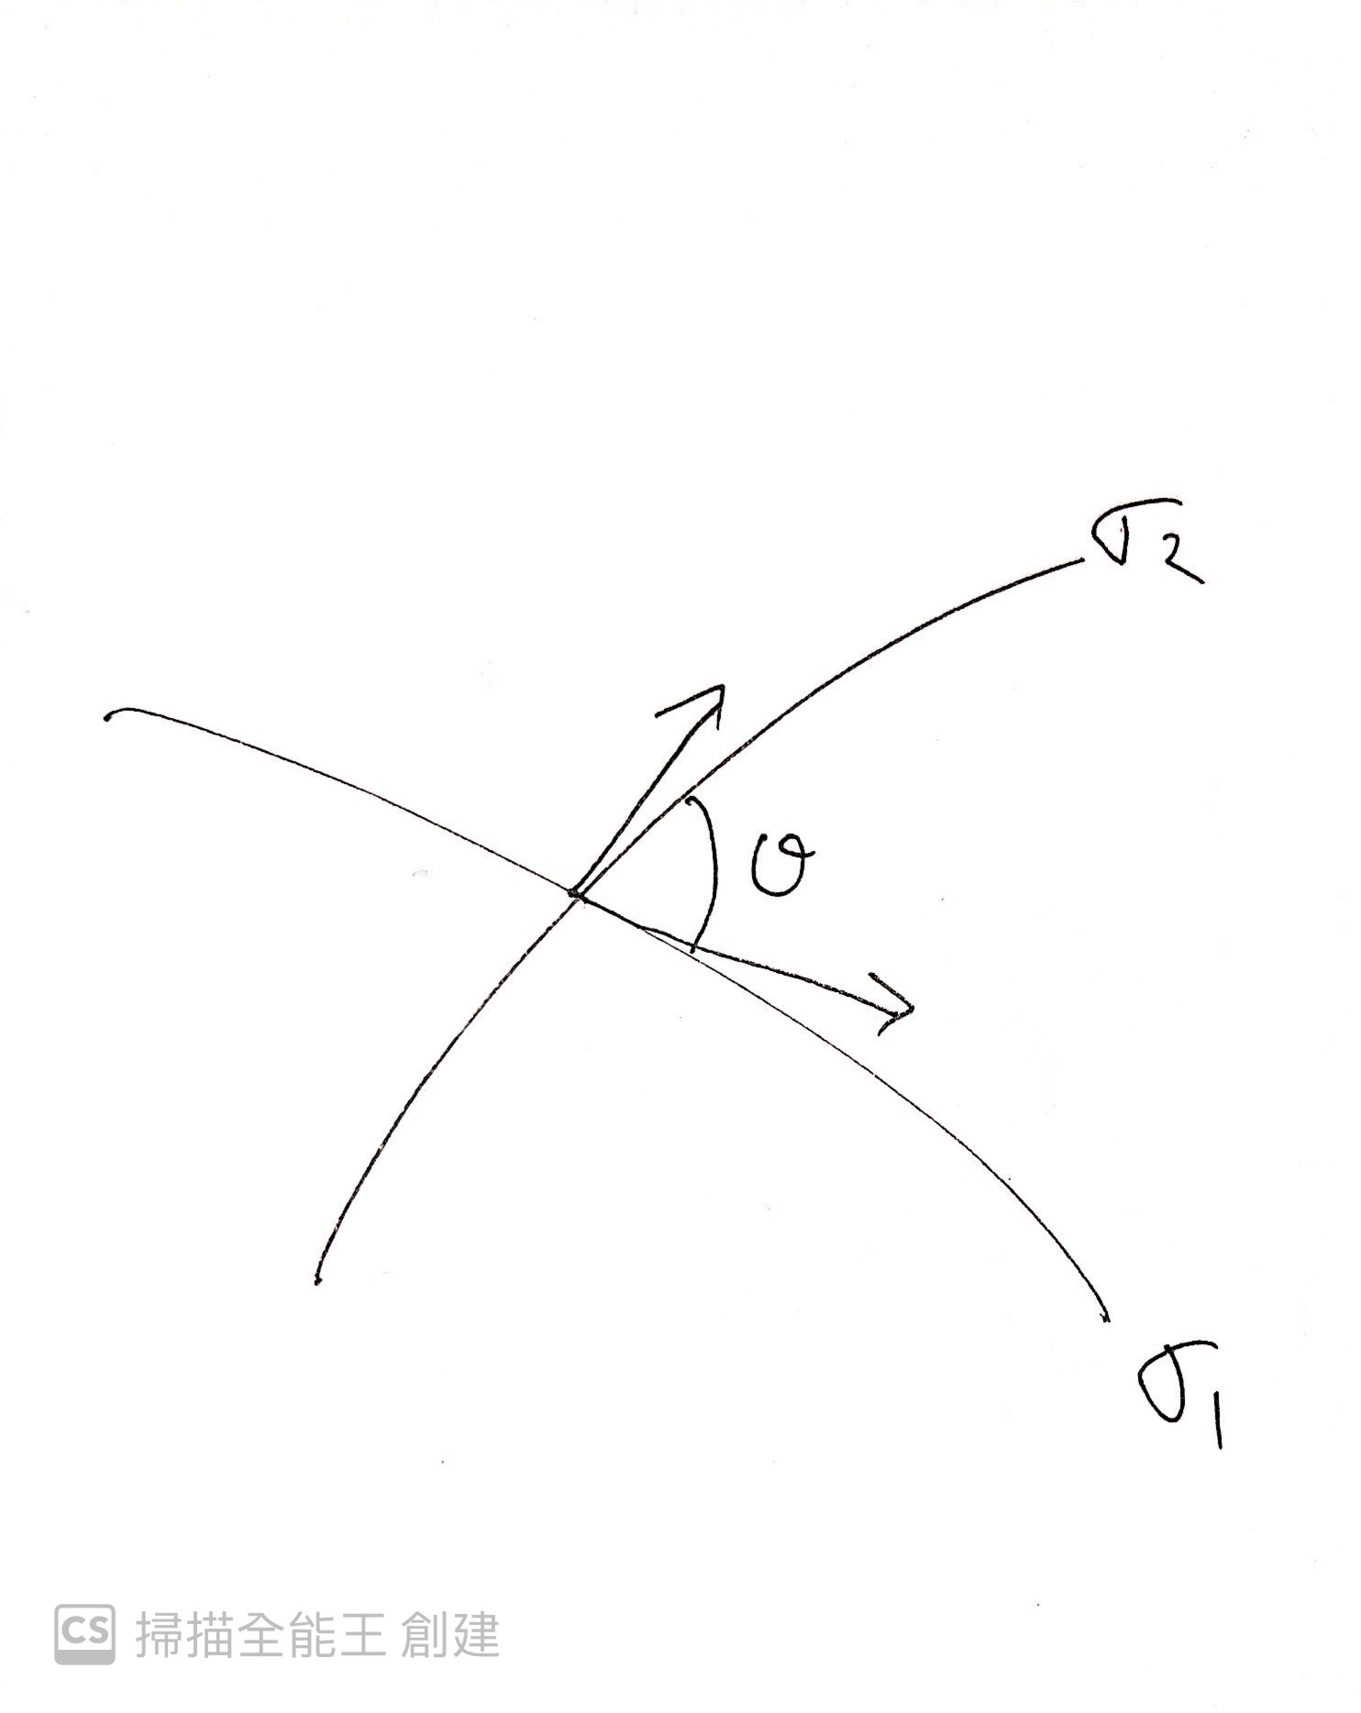
Angle
The angle between σ1 and σ2 at z is defined to be the angle between their tangent vectors at the point of intersection and is denoted by θ

Slide 47
Angle
Proposition 1
Let γ ∈ Mob(H) be a Mobius transformation of H. Then γ is conformal.
That mean σ1 and σ2 are two paths that intersect at z with angle θ, then the paths γσ1 and γσ2 intersect at γ(z) also with angle θ

Slide 48
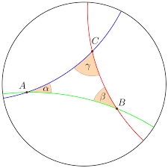
Triangle
Definition of ideal vertex
let △ABC be a hyperbolic triangle
The vertices of △ABC lie on the boundary of the hyperbolic plane, is called ideal vertex
Definition of ideal triangle
if all vertex lie on the the boundary of the hyperbolic plane. it call an ideal triangle
the angle at an ideal vertex is zero

Slide 49
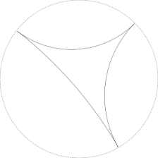
Triangle
The Poincare disc

Slide 50
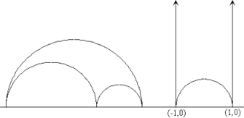
Triangle
The upper half-plane

Slide 51
Triangle
Proposition 2: The angle sum of a hyperbolic triangle is strictly less than π
Proof
Put the hyperbolic triangle ∆ in D with one vertex at the centre O. The sides through O are radii. If
P, P’ are the other two vertices, it is easy to see that the Euclidean triangle with vertices OPP’
strictly contains ∆, and in particular, that the ∠OPP’ , ∠OP’ P in ∆ are less than the corresponding

Slide 52
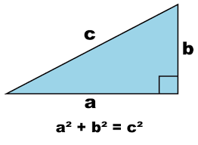
Triangle
Right-angle triangle
Pythagoras’ Theorem in Euclidean geometry

Slide 53
Trigonometry
some fact about hyperbolic trigonomy
sinh(x) = ( e^{x} - e^{-x} )/2
cosh(x) = ( e ^{x} + e ^{-x} )/2
tanh(x) = sinh(x)/cosh(x) = ( e^{x} - e^{-x} )/( e^{x} + e^{-x} )
cosh^2-sinh^2=1
cosh(x+y)=cosh(x)cosh(y)+sinh(x)sinh(y)

Slide 54
Trigonometry
Right-angle triangle
Pythagoras’ Theorem in hyperbolic geometry
Theorem (Pythagoras’ Theorem)
Let ∆ be a right-angled triangle in H with internal angles α, β, π/2 and opposing sides with lengths
a, b, c. Then cosh(c)=cosh(a)*cosh(b)
Recall
let z,w ∊H, let dH(z,w) be the metric in upper half -plane we have
cosh(dH(z,w))=1+(|z-w|^2)/(2lm(z)lm(w))

Slide 55
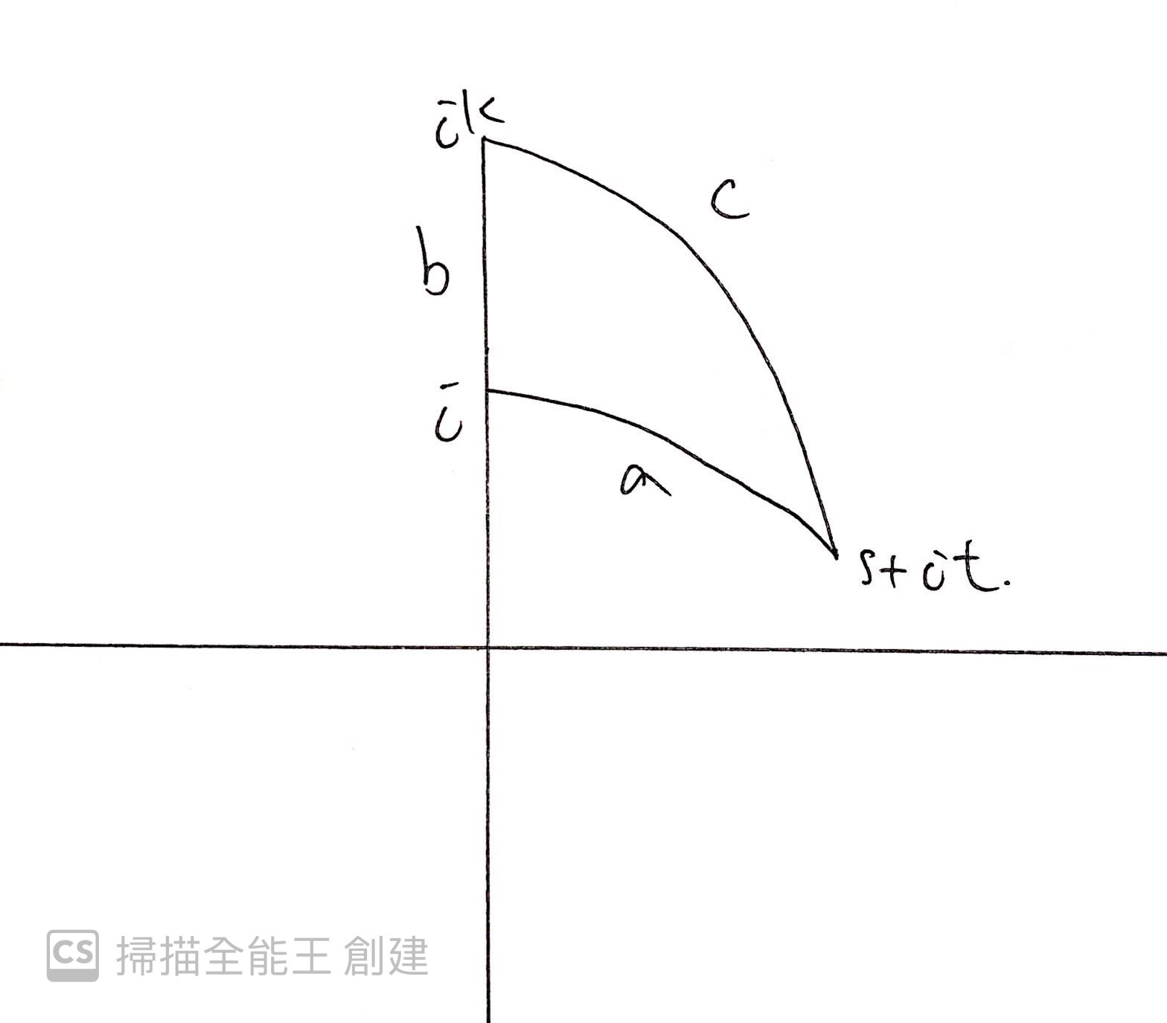
Trigonometry
Proof of Pythagoras’ Theorem :
Let ∆ be a triangle satisfying the hypotheses of the theorem. By applying a Mobius transformation
of H, we may assume that the vertex with internal angle π/2 is at i and that the side of length b
lies along the imaginary axis. It follows that the side of length a lies along the geodesic given by the semi-circle centred at the origin with radius 1. Therefore, the other vertices of ∆ can be taken to be at ik for some k > 0 and at s + it, where s + it lies on the circle centred at the origin and of radius 1.

Slide 56
Proof of Pythagoras’ Theorem (con’t):
since we have cosh(dH(z,w))=1+(|z-w|^2)/(2lm(z)lm(w))
cosh(a)=cosh(dH(s+it,i)) = 1+(|s+i(t-1)|^2)/2t = 1+(s^2+(t-1)^2)/2t=1/t (since s^2+t^2=1).....(1)
cosh(b) =cosh(dH(ik,i)) = 1+(k-1)^2/2k=(1+k^2)/2k…….(2)
cosh(c) = cosh(dH(s+it,ik))= 1+|s+i(t-k)|^2/2tk=1+(s^2+(t-k)^2)/2tk=(1+k^2)/2tk…….(3)
combin (1),(2)and (3) we have
cosh(c)=cosh(a)*cosh(b)

Slide 57
Trigonometry
For a right-angled triangle in Euclidean geometry we have the following relationships
sin(A)=b/c , cos(A)=a/c, tan(A)=b/a
For a right-angle triangle in hyperbolic geometry we will have the
similar property
Proposition 3
Let ∆ be a right-angled triangle in H with internal angles α, β, π/2 and opposing sides with lengths a, b, c.
Then (i) sin(α)=sinh(a)/sinh(c)
(ii)cos(α)=tanh(b)/tanh(c)
(iii)tan(α)=tanh(a)/sinh(b)

Slide 58
Trigonometry
Proof of Proposition 3 :
The setting is same as the proof of Theorem 1
we can apply a Mobius transformation of H to ∆ and assume without loss in generality that the vertices of ∆
are at i, ki and s + it, where s + it lies in the unit circle centred at the origin and the right-angle occurs at i.

Slide 59
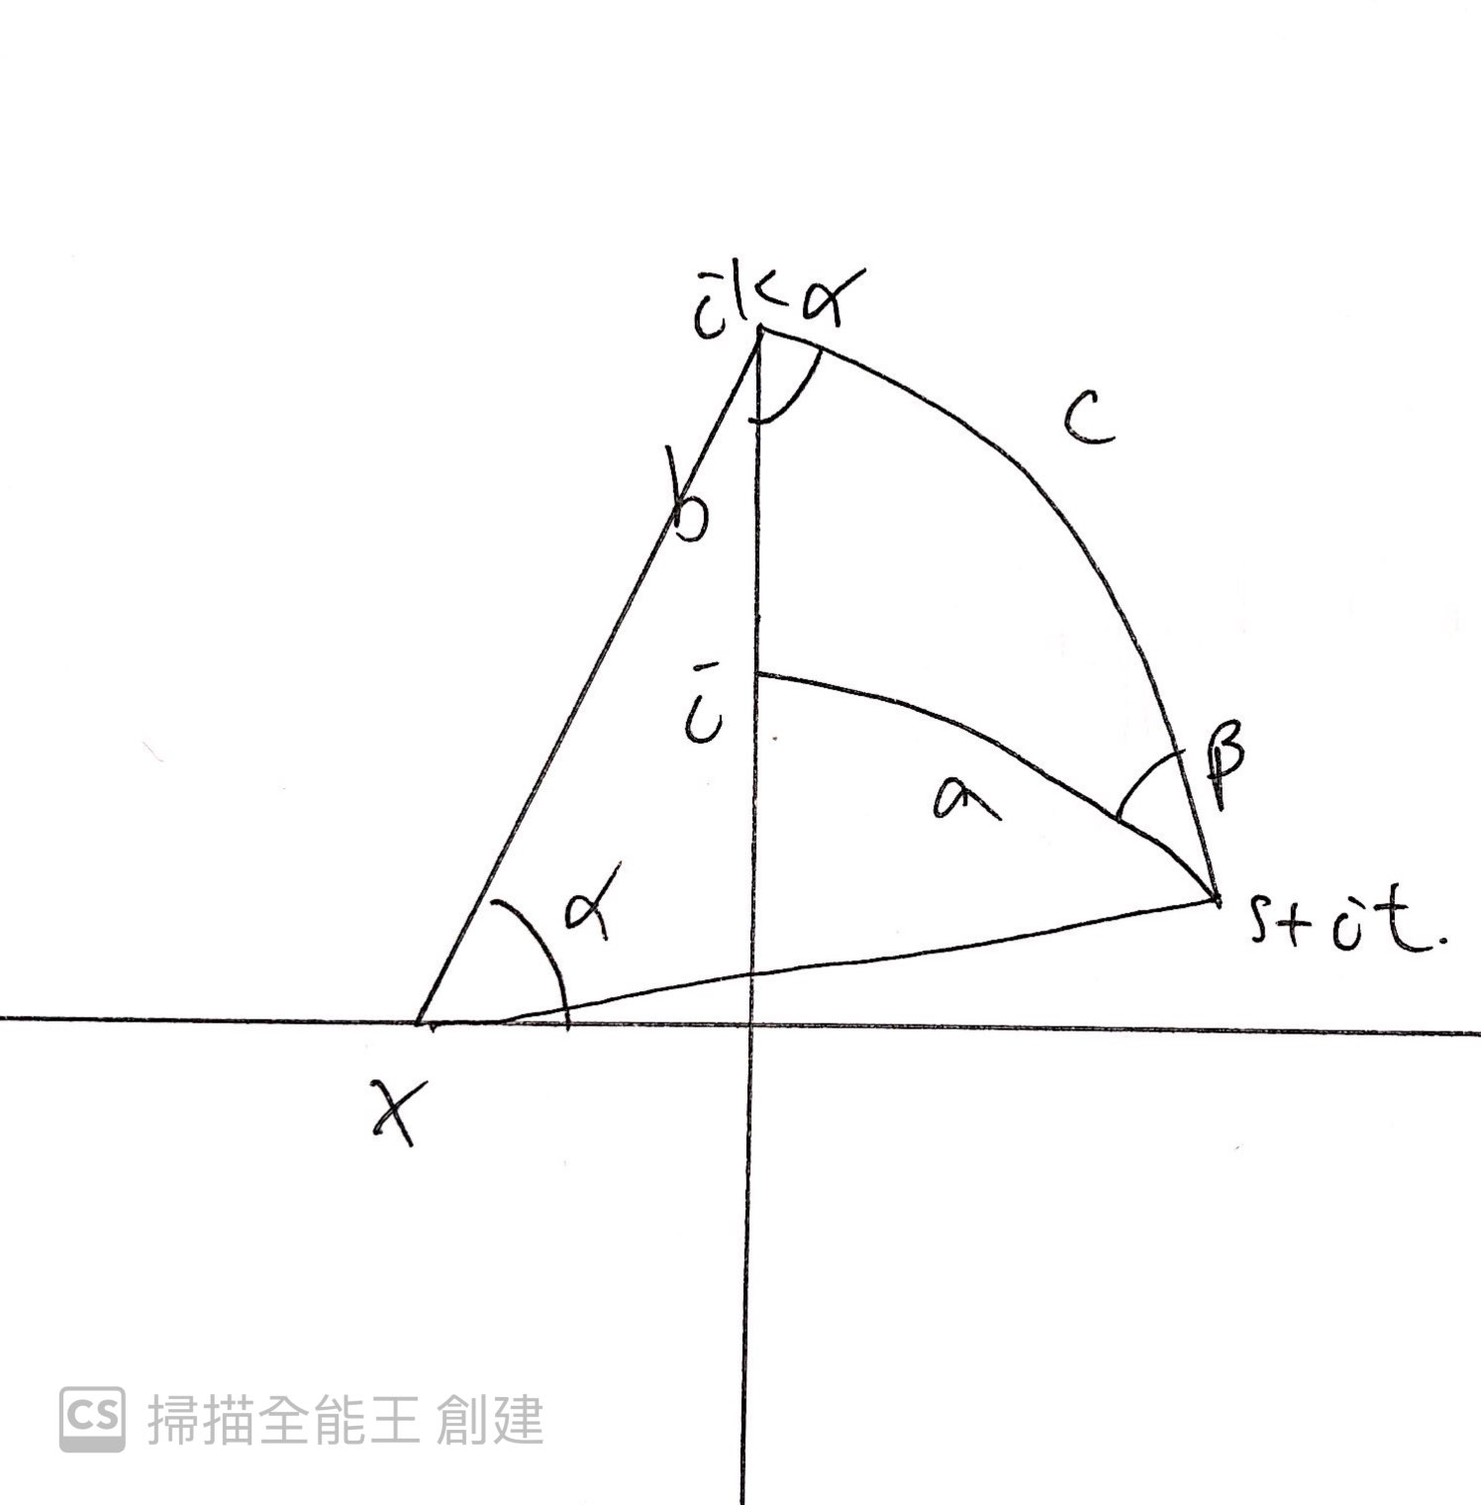
Trigonometry
Proof of Proposition 3 :
The vertices at ik and s + it lie on a unique geodesic. This geodesic is a semi-circle with centre x ∈ R. The
Euclidean straight line from x to ik is inclined at angle α from the real axis.
The line from x to ik is a radius of this semi-circle, as is the line from x to s + it.
we have
k^2+x^2=(s+x)^2+t^2
k^2=1+2sx (since s^2+t^2=1)

Slide 60
Trigonometry
Proof of Proposition 3 :
By considering the Euclidean triangle with vertices at x, ik, 0, we see that
tan(α)=k/x=2ks/(k^2-1)
Using the fact that cosh^2-sinh^2=1 and tanh=sinh/cosh we have
sinh(b)=(k^2-1)/2k , tanh(a)=s
finally , we have tan(α)=tanh(a)/sinh(b)
The other two statements follow by using trigonometric identities, relationships
between sinh and cosh, and the hyperbolic version of Pythagoras’ Theorem.

Slide 61
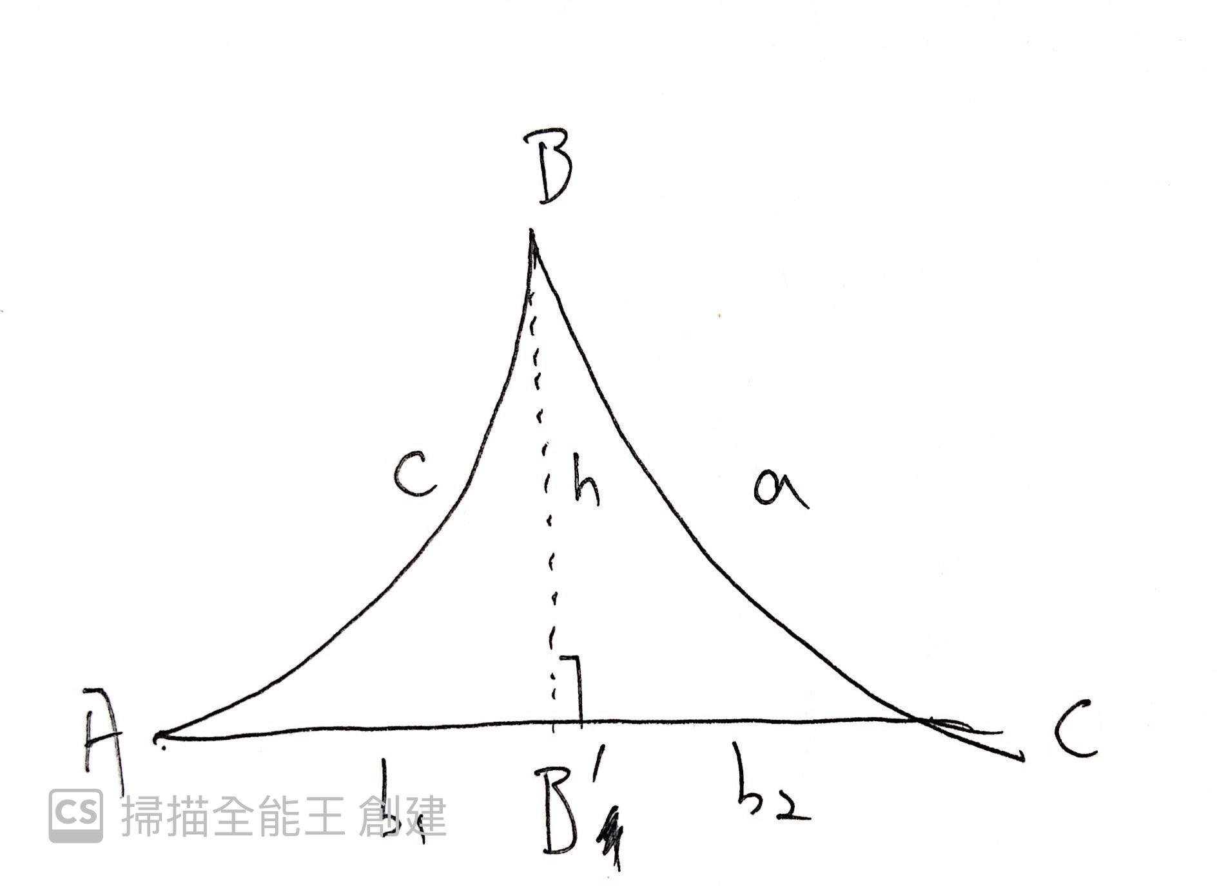
Trigonometry
Sine rule
Theorem 2 (sine rule)
Let ∆ be a hyperbolic triangle with internal angles α, β and γ and side lengths a, b, c. Then
sin(α)/sinh(a)=sin(β)/sinh(b)=sin(γ)/sinh(c)
Proof :
Let ∆ABC be a hyperbolic triangle , we draw a line from the vertex B to AC which is perpendicular to AC, denote h . it separate AC into two part AB’ and B’C

Slide 62
Trigonometry
Proof:
Applying Proposition 3 to the right angle triangle ABB’ we have
sin(A)=sinh(h)/sinh(c)
sinh(h)=sin(A)sinh(c)....(1)
Similarly Applying Proposition 3 to the right angle triangle B’BC we have
sin(h)=sin(C)sinh(a)....(2)
combine (1)and (2) we have
sin(A)/sinh(a)=sin(B)/sinh(b)

Slide 63
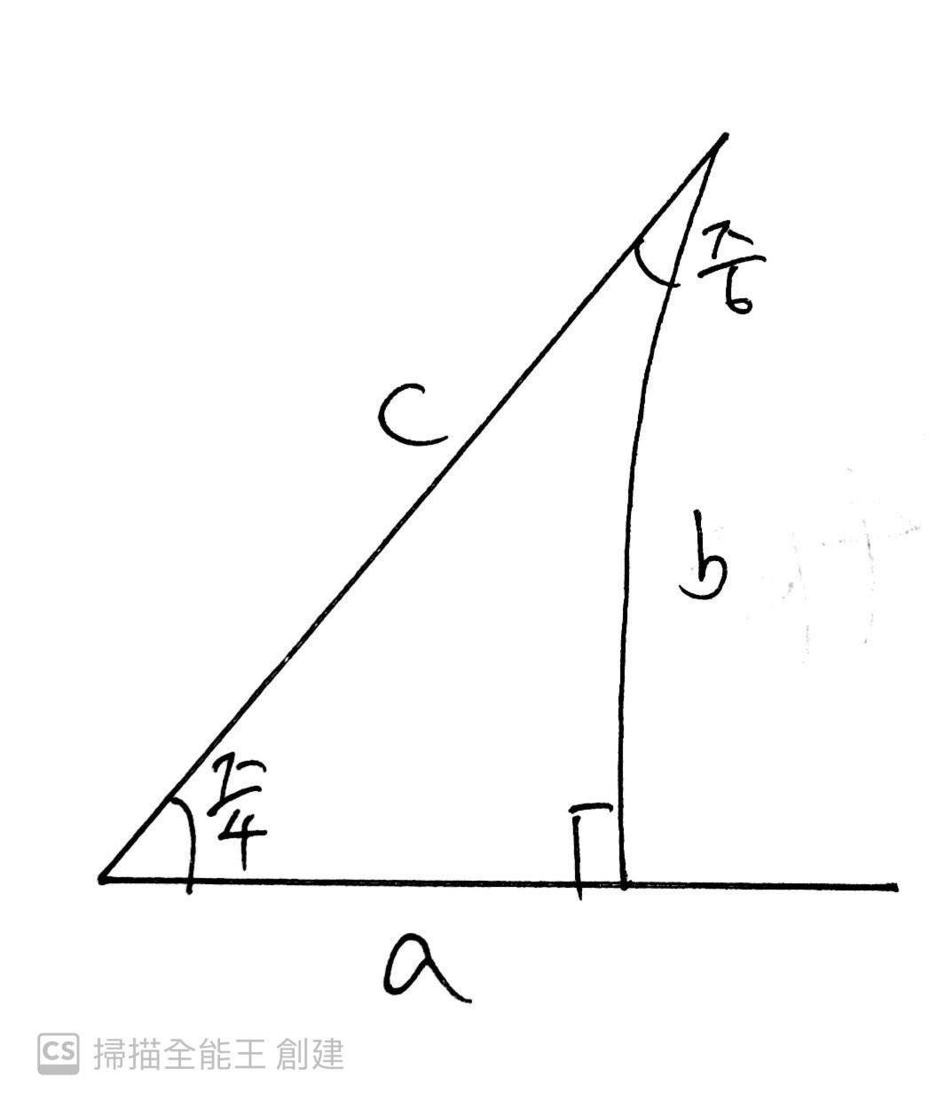
Trigonometry
Example :
Consider A right-angle triangle has angle π/6,π/4 and π/2 find its sides
Using the tan-formula
1/sqrt(3)=tan(π/6)=tanh(b)/sinh(a)=sinh(b)/(sinh(a)cosh(b))....(1)
1=tan(π/4)=tanh(a)/sinh(b)=sinh(a)/(cosh(a)sinh(b)).....(2)
(1)x(2) we have
1/sqrt(3)=1/cosh(a)cosh(b)=1/cosh(c)
c=cosh^-1(sqrt(3))=ln(sqrt(3)+sqrt(2))≈1.1462

Slide 64
Trigonometry
Example :
c=cosh^-1(sqrt(3))=ln(sqrt(3)+sqrt(2))≈1.1462
sinh(c)=sqrt(cosh^2(c)-1)=sqrt(2), since cosh^2-sinh^2=1
By sine rule we have
sinh(b)=sin(π/4)*sinh(c)/sin(π)=1
b=sinh^-1(1)≈0.8814
cosh(a)=cosh(c)/cosh(b)=sqrt(3/2) (by Pythgaoras’ thm)
a≈0.6565

Slide 65
Trigonometry
Theorem 3 (cosine rule I)
Let ∆ be a hyperbolic triangle with internal angles A, B and C and side lengths a, b, c. Then
cosh c = cosh a cosh b − sinh a sinh b cos C.
Proof :
The setting is same as the proof of theorem 2(sine rule)
Let ∆ABC be a hyperbolic triangle , we draw a line from the vertex B to AC which is perpendicular to AC, denote h . it separate AC into two part AB’ and B’C

Slide 66
Trigonometry
Proof :
Applying the Pythagoras’ theorem to the right angle triangle B’BC
cosh(a)=cosh(b2)cosh(h)
let b2=b-b1, where b is the length of AC
Using the fact cosh(x-y)=cosh(x)cosh(y)-sinh(x)sinh(y) we have
cosh(a)=cosh(b)cosh(b1)cosh(h)-sinh(b)sinh(b1)cosh(h)
Appying the Pythagoras’ theorem to the right angle triangle AB’B
we have cosh(h)=cosh(c)/cosh(b1)

Slide 67
Trigonometry
Proof :
we have cosh(h)=cosh(c)/cosh(b1)
replace the cosh(h)
cosh(a)=cosh(b)cosh(c)-sinh(b)sinh(b1)cosh(c)/cosh(b1)
that is
cosh(a)=cosh(b)cosh(c)-sinh(b)sinh(c)tanh(b1)/tanh(c)
cosh(a)=cosh(b)cosh(c)-sinh(b)sinh(c)cos(A) ( Proposition 3)

Slide 68
Trigonometry
Theorem 4 (cosine law II)
Let ∆ be a hyperbolic triangle with internal angles A, B and C and side lengths a, b, c. Then
cos(B) = -cos(A) cos(C) + sin(A) sin(C) cosh(b).
Proof : The setting is same as the proof of theorem 3
Applying Pyth’thm to triangle AB’B and B’BC and then multiply them
together we have cosh(a) cosh(c) = cosh^2 (h) cosh(b1) cosh(b2)
mutiply both side by cosh(b)=cosh(b1+b2) , where b is the length
cosh(a) cosh(c)(cosh(b1) cosh(b2) + sinh(b1) sinh(b2)) = cosh(b) cosh^2 (h) cosh(b1) cosh(b2).

Slide 69
Trigonometry
Theorem 4 (cosine law II)
Proof :
cosh(a) cosh(c)(cosh(b1) cosh(b2) + sinh(b1) sinh(b2)) = cosh(b) cosh^2 (h) cosh(b1) cosh(b2).
Replacing cosh^2(h) with 1+sinh^2(h) and dividing both sides by cosh(b1) cosh(b2)
cosh(a) cosh(c)(1 + tanh(b1) tanh(b2)) = cosh(b)(1 + sinh^2(h)).
After rearranging we get
cosh(a) cosh(c) -cosh(b) = - tanh(b1) tanh(b2) cosh(c) cosh(a) + sinh^2 (h) cosh(b)
By Theorem 3 we may replace cosh(a)cosh(c)-cosh(b)by cos(B)sinh(a)sinh(c)
cos(B) sinh(a) sinh(c) = − tanh(b1) tanh(b2) cosh(c) cosh(a) + sinh2 (h) cosh(b).

Slide 70
Trigonometry
Proof :
cos(B) sinh(a) sinh(c) = − tanh(b1) tanh(b2) cosh(c) cosh(a) + sinh^2(h) cosh(b).
cos(B)=(-tanh(b1)tanh(b2))/tanh(c)tanh(a)+(sinh(h)/sinh(c))(sinh(h)/sinh(a))cosh(b)
cos(B) = -cos(A) cos(C) + sin(A) sin(C) cosh(b). (by Proposition 3)

Slide 71
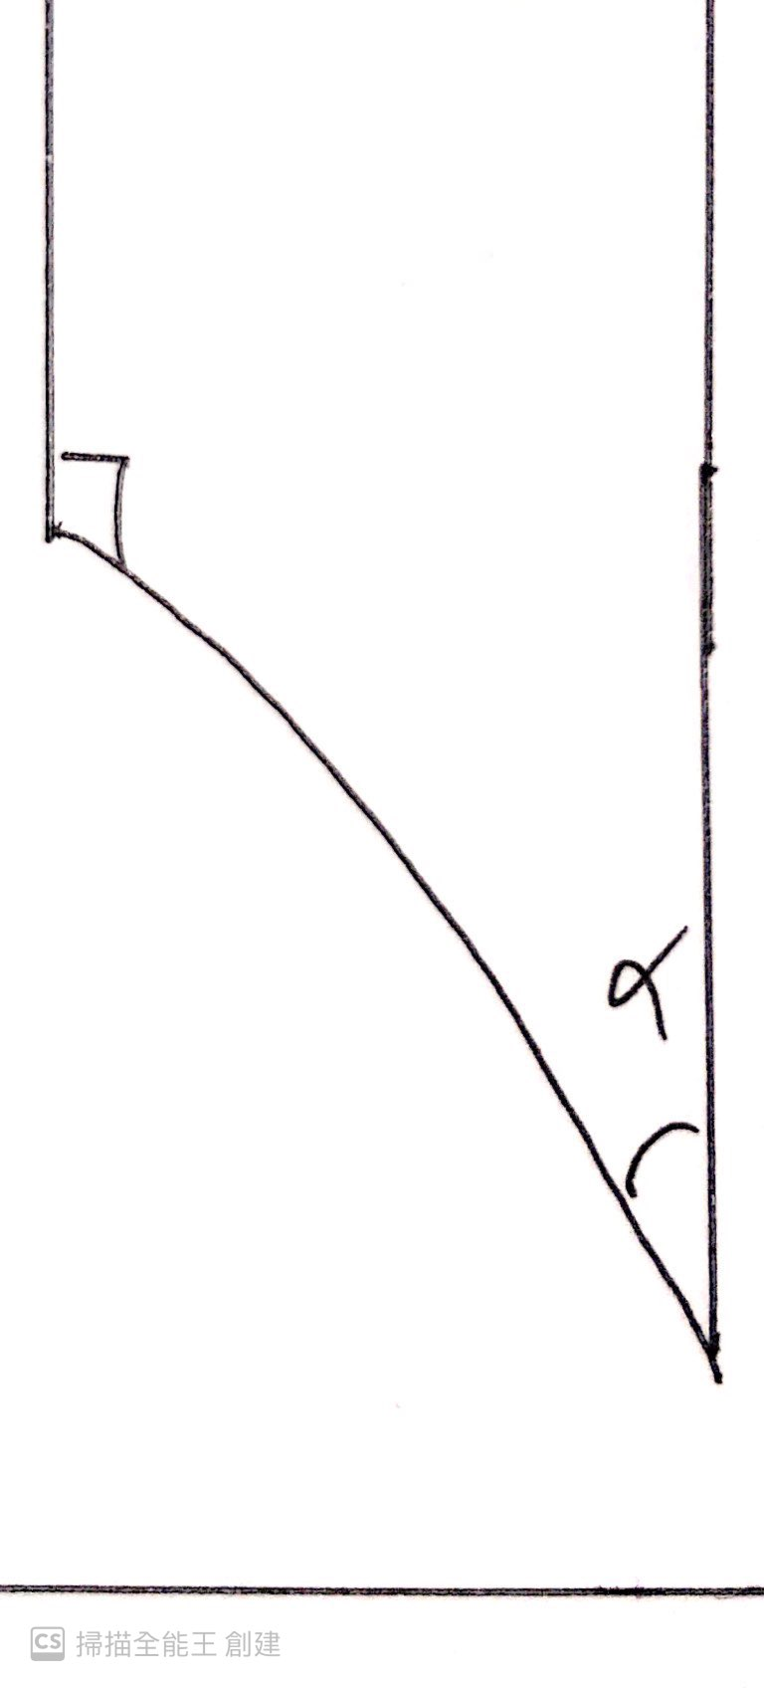
Trigonometry
The angle of parallelism
Consider the special case of a right-angled triangle with one ideal vertex . In this case, the internal angles of the triangle are α, 0 and π/2 and the only side with finite length is that between the vertices with internal angles α and π/2.

Slide 72
Trigonometry
Proposition 4
Let ∆ be a hyperbolic triangle with angles α, 0 and π/2. Let a denote the length of the only finite side. Then
(i) sin(α)=1/cosh(a)
(ii)cos(α)=1/coth(a)
(iii)tan(α)=1/sinh(a)
Proof :
The three formulae for α are easily seen to be equivalent. Therefore we need only prove that (i) holds

Slide 73
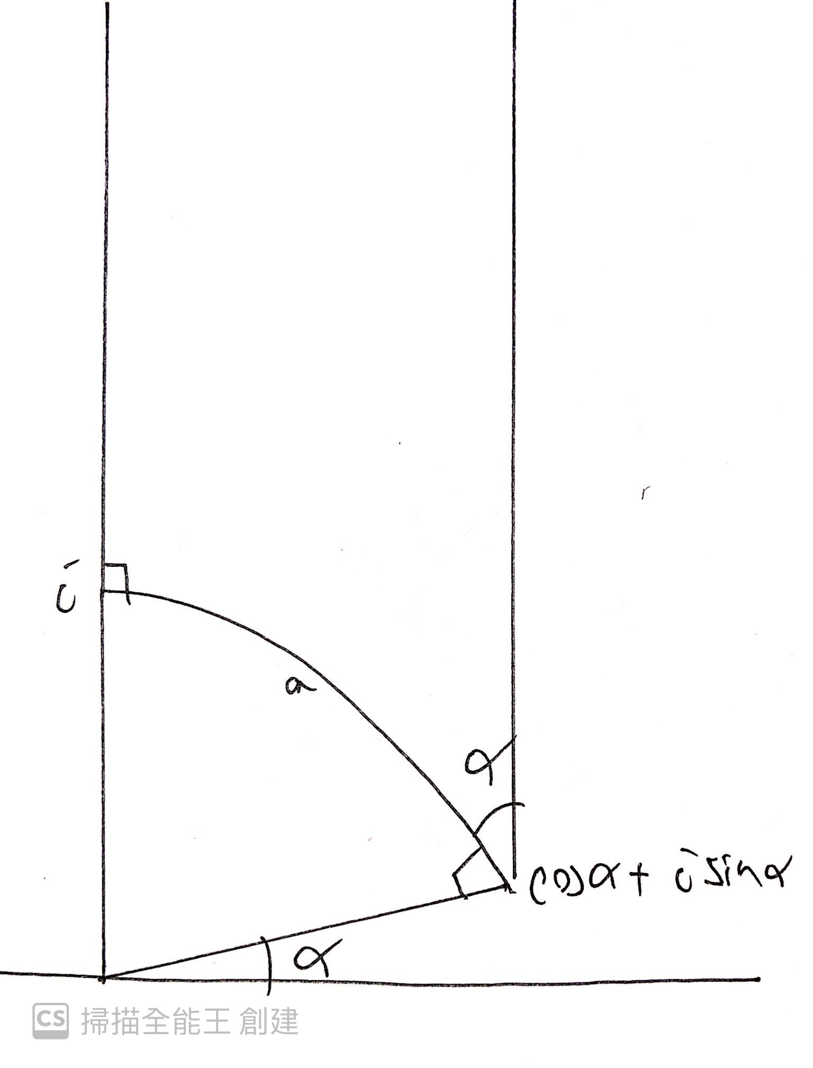
Trigonometry
Proof :
The three formulae for α are easily seen to be equivalent. Therefore we need only prove that (i) holds
After applying a Mobius transformation of H, we can assume that the ideal vertex of ∆ is at ∞ and that the
vertex with internal angle π/2 is at i. The third vertex is then easily seen to be at cos α + isin α.
Recall that
cosh(dH(z,w))=1+(|z-w|^2)/(2lm(z)lm(w))
sub z =i and w=cos α + isin α.
cosh(a)=1+(2-2sin(α))/2sin(α)=1/sin(α)

Slide 74
Summary
 | Euclidean geometry | Hyperbolic geometry
sine rule | sin(∠A)/a=sin(∠B)/b=sin(∠C)/c | sin(∠A)/sinh(a)=sin(∠B)/sinh(b)=sin(∠C)/sinh(c)
cosine law | c^2=a^2+b^2-2abcos(∠C) | cosh(c) = cosh(a)cosh(b)-sinh(a)sinh(b)cos(∠C) or cos(∠B) = -cos(∠A) cos(∠C) + sin(∠A) sin(∠C) cosh(b).
Pythagoras’ theorem | a^2+b^2=c^2 | cosh(c)=cosh(a)cosh(b)
angle sum of triangle | =π | <π
angle | same | same

Slide 75
Hyperbolic Tessellation

Slide 76
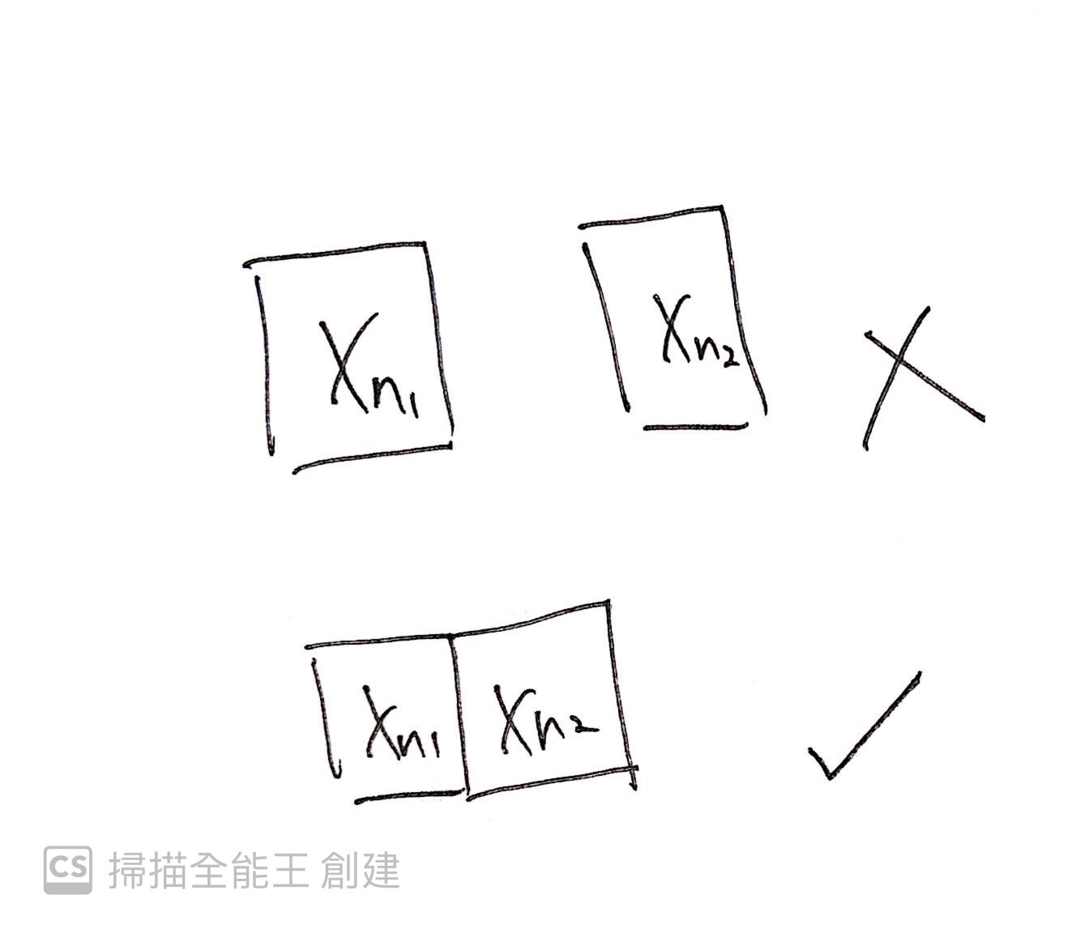
Hyperbolic tessellation
Recall the defintion of tessellation
A tessellation is a family of tiles Xn , n є IN , such that
(1)each tile Xn is connected polygon in the plane

Slide 77
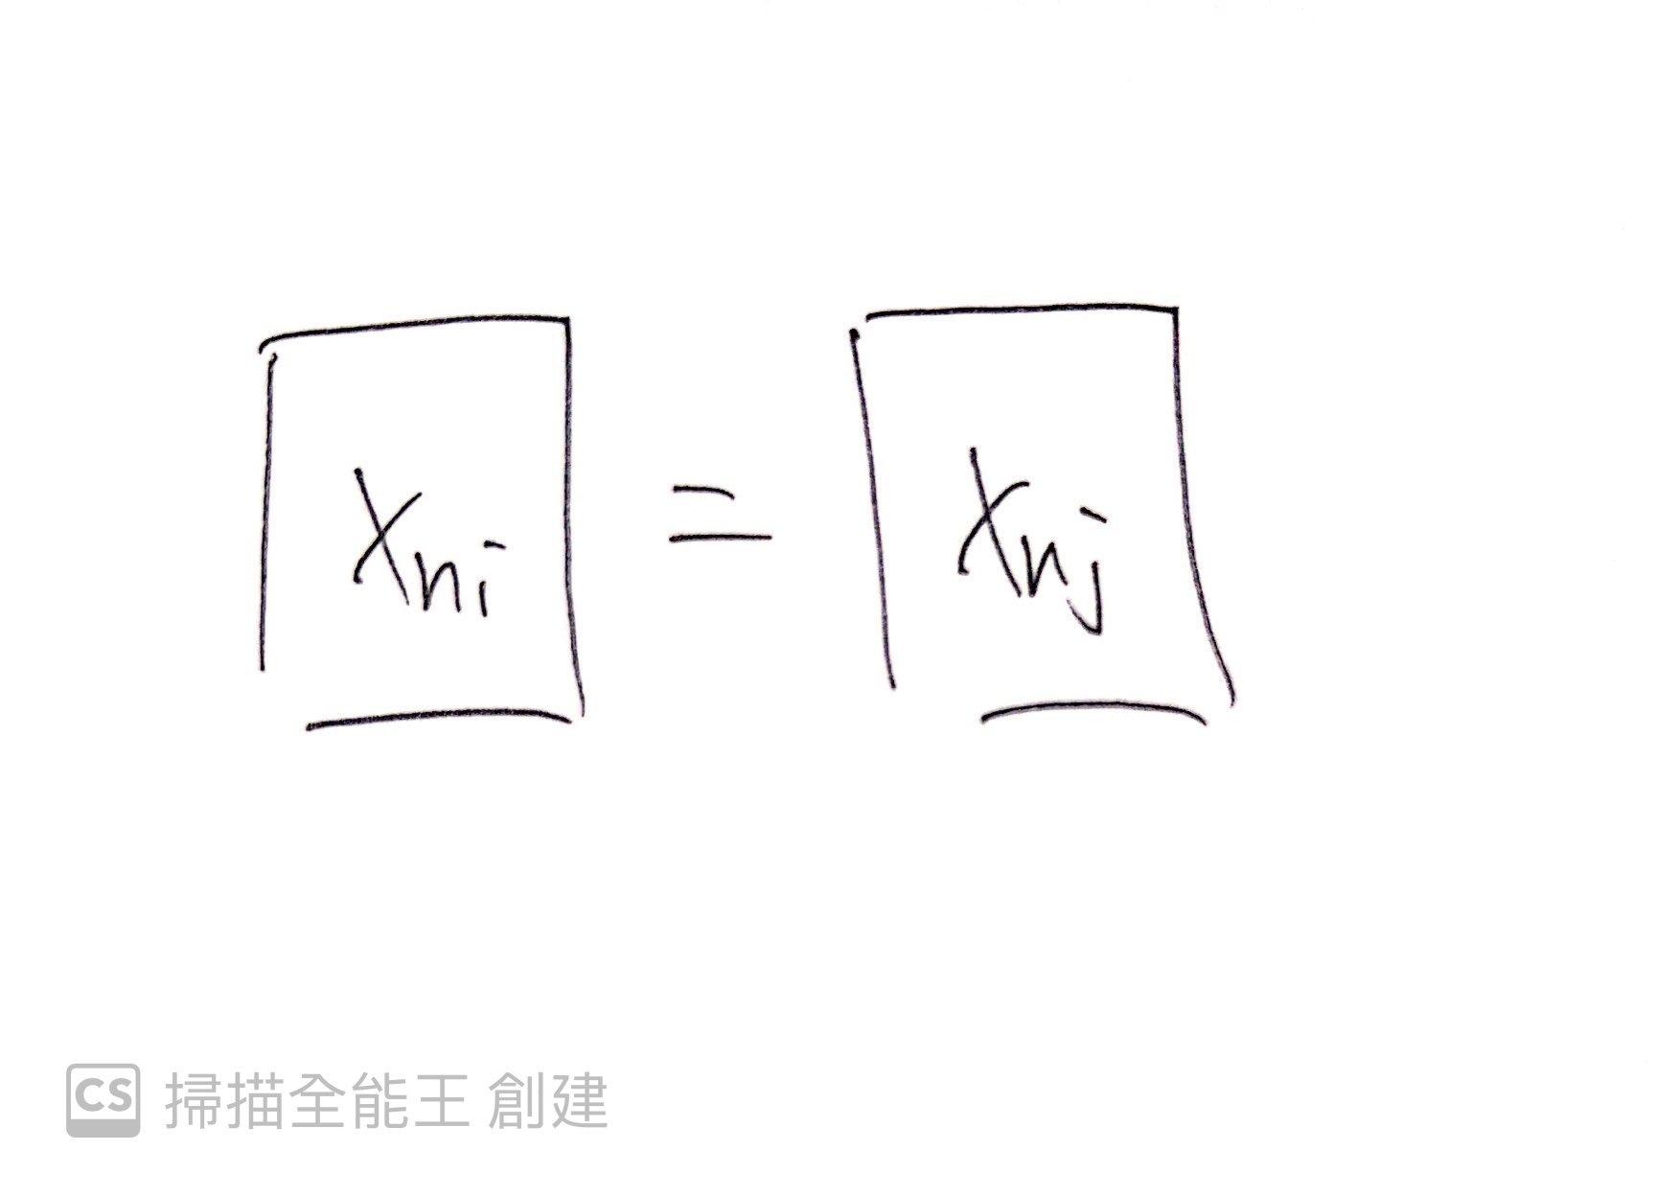
Hyperbolic tessellation
Recall the defintion of tessellation
A tessellation is a family of tiles Xn , n є IN , such that
(2)any two Xn, Xm are isometric

Slide 78
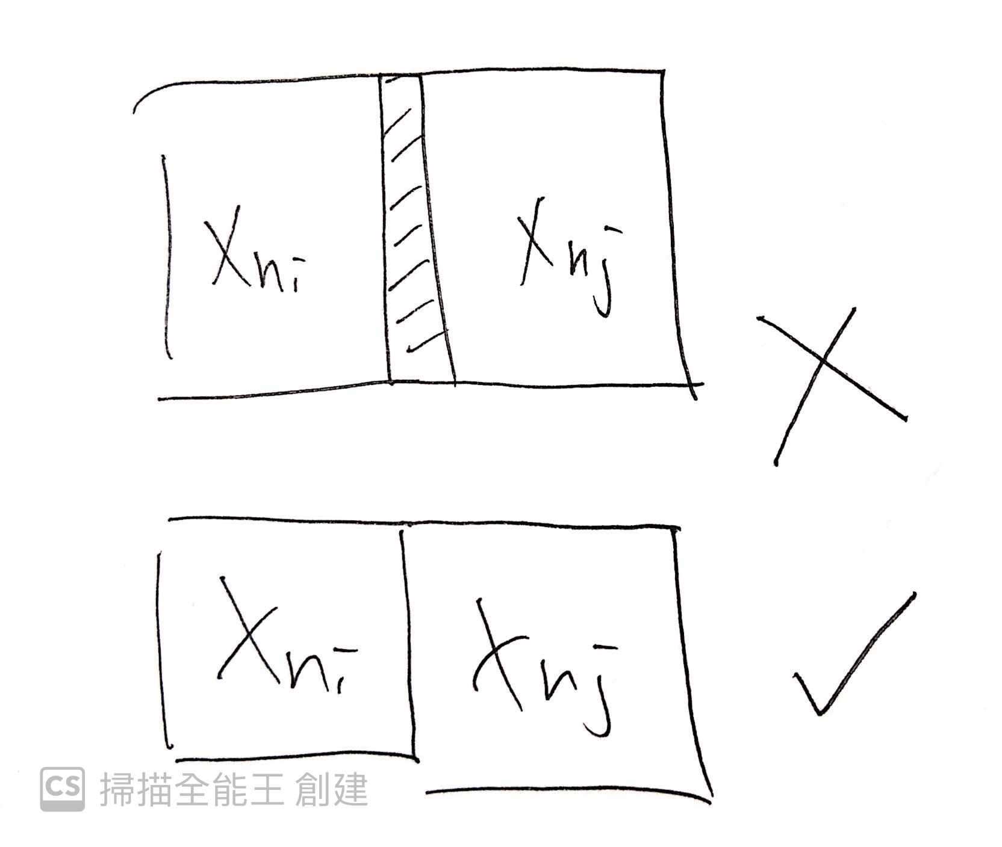
Hyperbolic tessellation
Recall the defintion of tessellation
A tessellation is a family of tiles Xn , n є IN , such that
(3)The Xn cover the whole plane
(4) The intersection of any two distinct Xn, Xm consist only of vertice and
edges of Xn , which are also vertice and edge of Xn

Slide 79
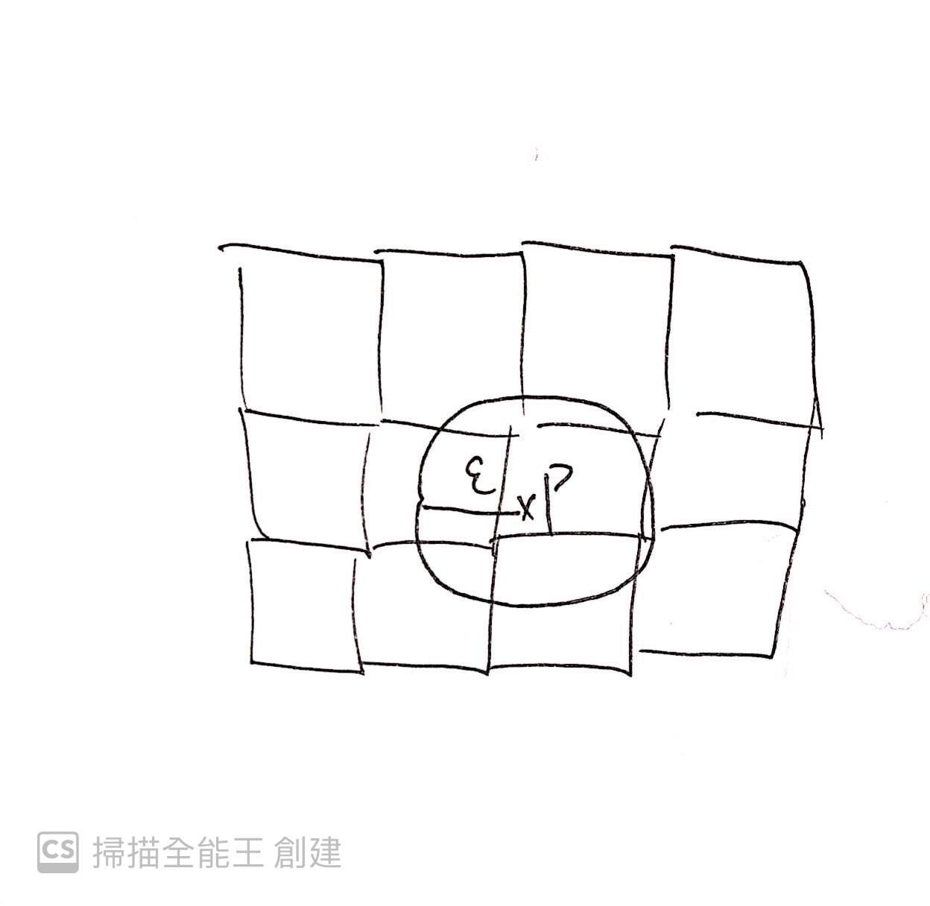
Hyperbolic tessellation
Recall the defintion of tessellation
A tessellation is a family of tiles Xn , n є IN , such that
(5)For every point P in the plane ,∃ an ε s.t. the ball of radius of ε
centered at P meet on finitely many tiles Xn

Slide 80
Hyperbolic tessellation
Theorem
There exists a tessellation of the hyperbolic plane by regular hyperbolic n-gons with k polygons meeting at each
vertex if and only if 1/n+1/k<½
Proof :
Suppose There exists a tessellation of the hyperbolic plane by regular hyperbolic n-gons with k polygons
meeting at each vertex .
Let α denote the internal angle of a regular n-gon P. Then as k such polygons meet at each vertex, we must have tha
t α = 2π/k. As the area of the polygon P must be positive, substituting α = 2π/k into Gauss-Bonnet formula for a
hyperbolic polygon and re-arranging we have: 1/n+1/k<½
omit , because it is very hard to prove

Slide 81
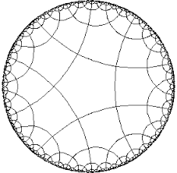
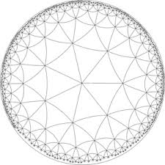
n=5 , k=4 1/4 +1/5<1/2 n=3,k=7 1/3+1/7<1/2

Slide 82
Hyperbolic tessellation
Tessellation by triangle
Theorem
For the Euclidean geometry
for any three integer a,b,c≥2
if π/a+π/b+π/c=π there exist a tessellation of euclidean plane by euclidean triangle of angle π/a,π/b.π/c
For the hyperbolic geometry
for any three integer a,b,c≥2
if π/a+π/b+π/c<π there exist a tessellation of hyperbolic plane by hyperbolic triangle of angle π/a,π/b.π/c

Slide 83
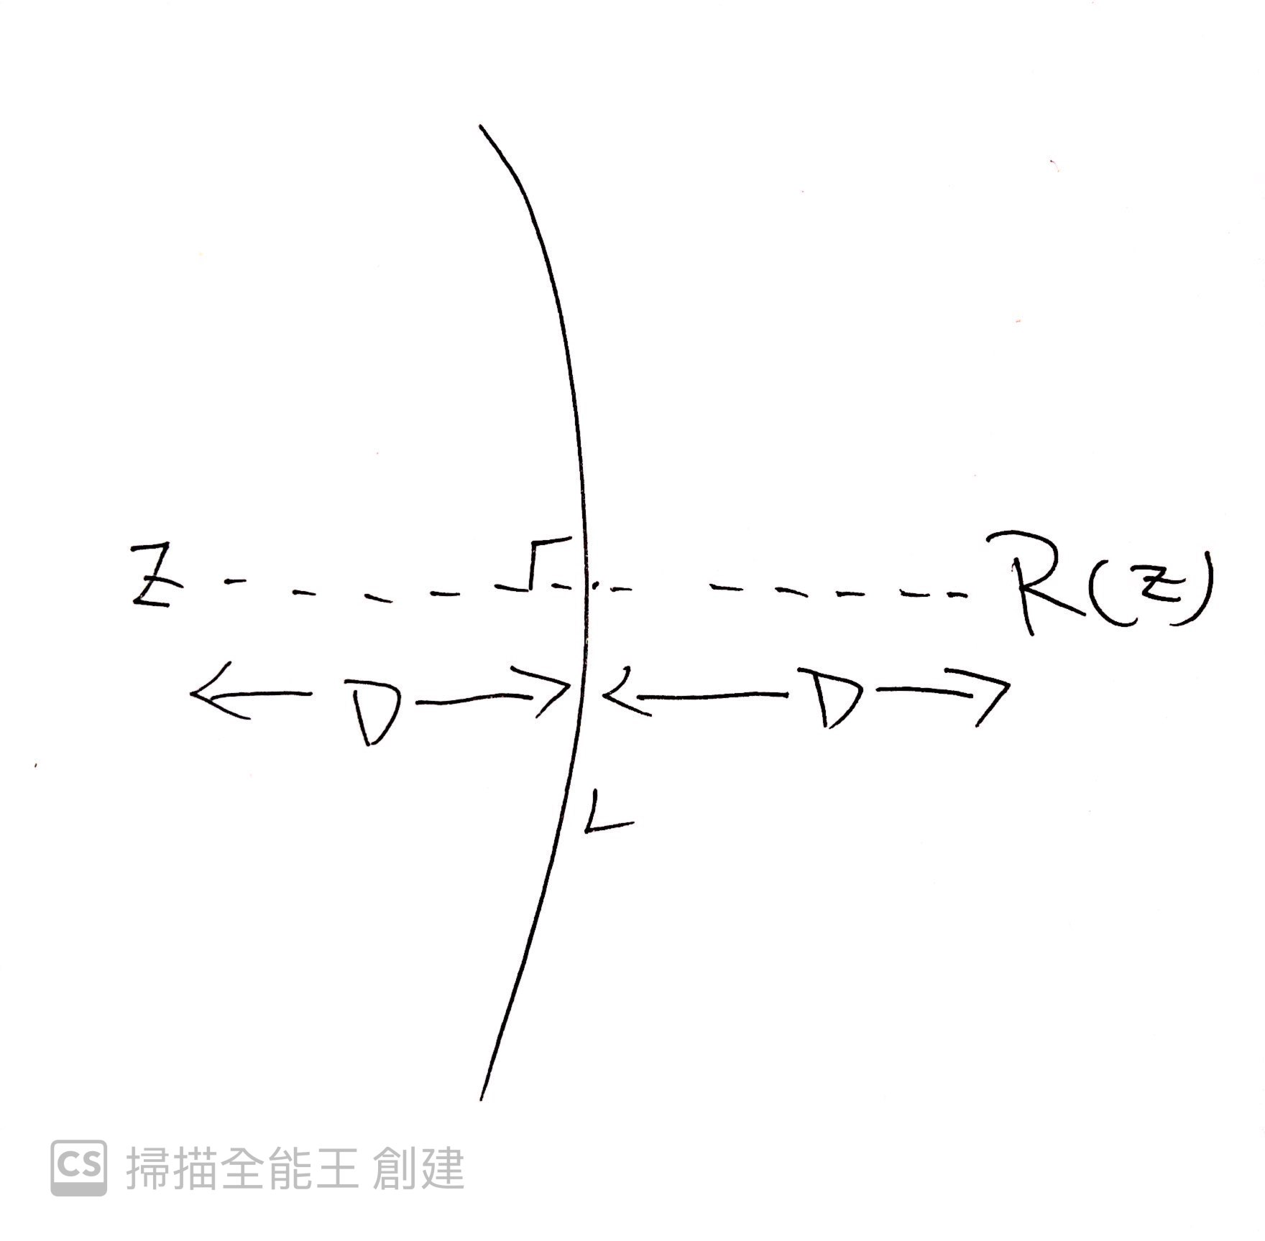
Hyperbolic tessellation
Why have integer denominators? π/a,π/b,π/c
Reflection of hyperbolic triangle
we define a map R:H^2-->H^2 by R(z)=(az+b)/(cz+d) , where z is the conjugate of z and a,b,c,d ∊IR

Slide 84
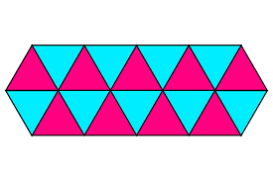
Hyperbolic tessellation
Defintion
A hyperbolic triangle group T is a group of transformations generate by the reflection R1,R2,R3 in the geodesic
L1,L2,L3 corresponding to the side of triangle , where ∠A=π/a,∠B=π/b,∠C=π/c , a,b,c∊IN ,a,b,c≥2,
1/a+1/b+1/c<1
eg (R1R2)^3=I
and the ∠A=π/3
that mean 2a is the number of the rotation at vertex A
which turn the triangle into the original position

Slide 85
Summary
 | Euclidean geometry | Hyperbolic geometry
What values of n can we tile the plane by regular n-gons | n=3,4,6 | infinitly many
Tessellation by triangle | π/a+π/b+π/c=π | π/a+π/b+π/c<π

Slide 86
Reference
Caroline Series . Lecture note. retrieved from https://homepages.warwick.ac.uk/~masbb/Papers/MA448.pdf
Francis Bonahon (2009). Low-Dimensional Geometry . American Mathematical Society
Charles Walkden .Lecture note. retrieved from https://personalpages.manchester.ac.uk/staff/charles.walkden/hyperbolic-geometry/hyperbolic_geometry_1920.pdf
Pollicott. lectures 13-18. retrieved from https://homepages.warwick.ac.uk/~masdbl/hg-lectures3.pdf
James W Anderson(1999). Hyperbolic geometry . Springer

